Slide 1
Objectives
In this session, you will learn to:
  Change the display
  Use accessories
Notes:
Share the session objectives with the students.

Slide 2

Changing the Display
How can we change the background of a desktop?

Slide 3
Changing the Display (Contd.)
The background of a desktop can be changed by using the Display Properties option.
  The Display Properties option enables you to:
  Change the desktop background.
  Change the colors of the desktop screen.
  Apply a screen saver.

Slide 4
Changing the Display (Contd.)
What is a screen saver?

Slide 5
Changing the Display (Contd.)
Screen saver refers to the images or special effects that are displayed on the screen automatically. It is displayed when the computer is on and left idle for some time.

Slide 6
Changing the Display (Contd.)
The various tabs displayed under Display Properties option are:
  Themes
  Desktop
  Screen saver
  Appearance
  Settings

Slide 7
Changing the Display (Contd.)
.
Let us see how to change the theme of a desktop.
Notes:
The following example can be given to explain the federated approach:
Consider a scenario where a manufacturing company called MakeProducts, Inc. is having several business processes and sister concerns. Each of the business processes and sister concerns have their own data warehouses. Now, consider a situation where the senior management of the company decides to develop a company- wide data warehouse encompassing the business processes and sister concerns. In such a case, the company can select the federated approach, where the existing data warehouses are integrated to form a company-wide data warehouse.

Slide 8
Changing the Display (Contd.)
.
Let us see how to change the background of a desktop.
Notes:
The following example can be given to explain the federated approach:
Consider a scenario where a manufacturing company called MakeProducts, Inc. is having several business processes and sister concerns. Each of the business processes and sister concerns have their own data warehouses. Now, consider a situation where the senior management of the company decides to develop a company- wide data warehouse encompassing the business processes and sister concerns. In such a case, the company can select the federated approach, where the existing data warehouses are integrated to form a company-wide data warehouse.

Slide 9
Changing the Display (Contd.)
.
Let us see how to apply the screen saver to a desktop.
Notes:
The following example can be given to explain the federated approach:
Consider a scenario where a manufacturing company called MakeProducts, Inc. is having several business processes and sister concerns. Each of the business processes and sister concerns have their own data warehouses. Now, consider a situation where the senior management of the company decides to develop a company- wide data warehouse encompassing the business processes and sister concerns. In such a case, the company can select the federated approach, where the existing data warehouses are integrated to form a company-wide data warehouse.

Slide 10
Changing the Display (Contd.)
.
Let us see how to change the appearance of a desktop.
Notes:
The following example can be given to explain the federated approach:
Consider a scenario where a manufacturing company called MakeProducts, Inc. is having several business processes and sister concerns. Each of the business processes and sister concerns have their own data warehouses. Now, consider a situation where the senior management of the company decides to develop a company- wide data warehouse encompassing the business processes and sister concerns. In such a case, the company can select the federated approach, where the existing data warehouses are integrated to form a company-wide data warehouse.

Slide 11
Changing the Display (Contd.)
.
Let us see how to change the resolution and color of a desktop.
Notes:
The following example can be given to explain the federated approach:
Consider a scenario where a manufacturing company called MakeProducts, Inc. is having several business processes and sister concerns. Each of the business processes and sister concerns have their own data warehouses. Now, consider a situation where the senior management of the company decides to develop a company- wide data warehouse encompassing the business processes and sister concerns. In such a case, the company can select the federated approach, where the existing data warehouses are integrated to form a company-wide data warehouse.

Slide 12
Using Accessories
An accessory is a powerful and fully integrated set of tools of Windows operating system.
The various options in accessories are:
  Calculator
  Notepad
  Paint

Slide 13
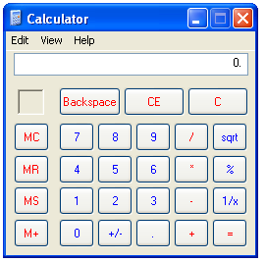
Using Accessories (Contd.)
Calculator:
  Is used to perform mathematical calculations.
  Can also perform complex statistical and scientific calculations.
  The following figure shows a Calculator.

Slide 14
Using Accessories (Contd.)
Notepad:
  It is used to write letters, short memos, resumes, and other documents.
  Some of the features of Notepad are:
    Word wrap
    Copying and pasting text
    Finding text

Slide 15
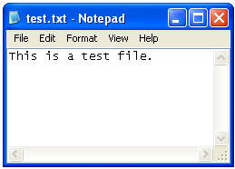
Using Accessories (Contd.)
  The following figure shows a Notepad.

Slide 16
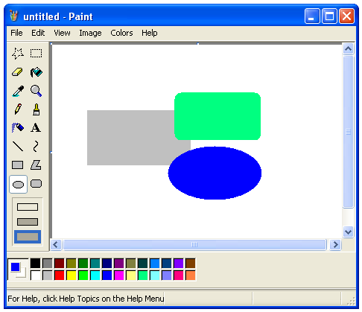
Using Accessories (Contd.)
Paint:
  It is used to draw images or drawings.
  The following figure shows the Paint window.
Toolbox

Slide 17
Summary
  In this lesson, you learned that:
  You can change the appearance of the Desktop screen by using the Display Properties option.
  Themes enable you to change:
    The Desktop appearance.
    The look of icons.
    The desktop background.
    The Mouse pointers.
    The screen saver.
    The system sound effects.
  The Desktop tab is used to apply a background or wallpaper to make the Desktop screen look more attractive.

Slide 18
Summary (Contd.)
  Screen saver is some attractive pictures or some special effects that are displayed on the screen automatically, if the computer is on and idle for some time.
  Calculator allows you to perform simple mathematical as well as complex statistical and scientific calculations.
  Notepad is used to write letters, short memos, resumes, and other documents.
  Paint is used to draw images.

Slide 19
Home Assignment
Let me give you some questions to solve at home.

